Slide 1

IT Cost Management
A Fundamental Requirement in the New Technology World
April 2010
Joseph Pynadath
Vice President – North America Field Operations
Tom Schaefer
Executive Vice President - Marketing

Slide 2














The IT Reality Today – A Complex World With Many Options!

Slide 3

The Result – What Does It Truly Cost To Provide These Services ?
How much does
it cost to deliver
this service?
What is driving
the high cost of
this service?
How many
people are consuming
this service?
Is there a cheaper
way to provide
this service?
How does
this cost compare to
our benchmarks?

Slide 4
What’s Required - Greater Visibility for IT Cost Management
IT Teams
Need to
make smart spending cuts
Where are we
underutilizing
resources?
What is the
business impact
of reduced
service level?
Business Units
Demand full
transparency into
significant IT spend
Demand For
IT Cost
Visibility
Finance
Tax regulations require detailed P&L reporting
on IT services
Do we really
use those
IT services?
How do our
IT costs
compare to
alternatives?
Which BUs
are the top
spenders by
IT service?
Does IT
chargeback
satisfy tax
regulations?

Slide 5

































500 Customers Rely on Digital Fuel
IT Cost & Service management experts since 2000
On Demand, End-to-End, Automated, Service Mgmt Solutions
2009 Pink Elephant “Innovation of the Year” Winner

Slide 6





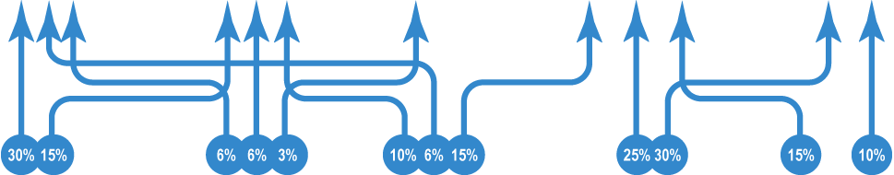









Digital Fuel’s Approach to IT Cost Management
Yearly Budgeting
Monthly Actual
vs. Forecast
& Reforecast
Business Unit
Cost Visibility
Executive Reporting
Cost Reduction Analysis
Pricing
Automate Business Processes
IT Capabilities
Business Apps
Servers
Storage
Help Desk
Desktop
Apply Cost Models
Cost Drivers
Network
Hardware
Software
Labor
Facilities
Connect Underlying Data
Data Types
GL Expenses, Budget, Usage, Cost Plan,
Utilization, Benchmarks, People, …

Slide 7
Significant Return on Investment
Engine Manufacturer
($15 billion in revenue)
Billing & Chargeback / Proactive Demand Management across all business units Hard dollar savings over $30 million
Insurance Company
($22 billion in revenue)
Cost Optimization through Unit Cost Analysis of IT Infrastructure
Saved over $20 million/year by reducing unit costs by at least 6% each year
Global Telco
($3 billion in revenue)
Margin management - for over 900 IP VPN network services
Margins increased by $12 million
Diversified Manufacturer
($98 billion in revenue)
Usage and Demand Management to standardize and optimize 4000 services Saved $5 million in the first 90 days
Consumer Products Co.
($7 billion in revenue)
Tax Regulation & Vendor Cost Mgmt
Accurate profitability reporting for Tax Audit. Cost Control of outsourcers
Health Care Provider
($10 billion in revenue)
Cost Reduction on IT projects and staffing
Eliminated over-budget situations which previously occurred in the millions$

Slide 8
Cost Management in Action

Slide 9
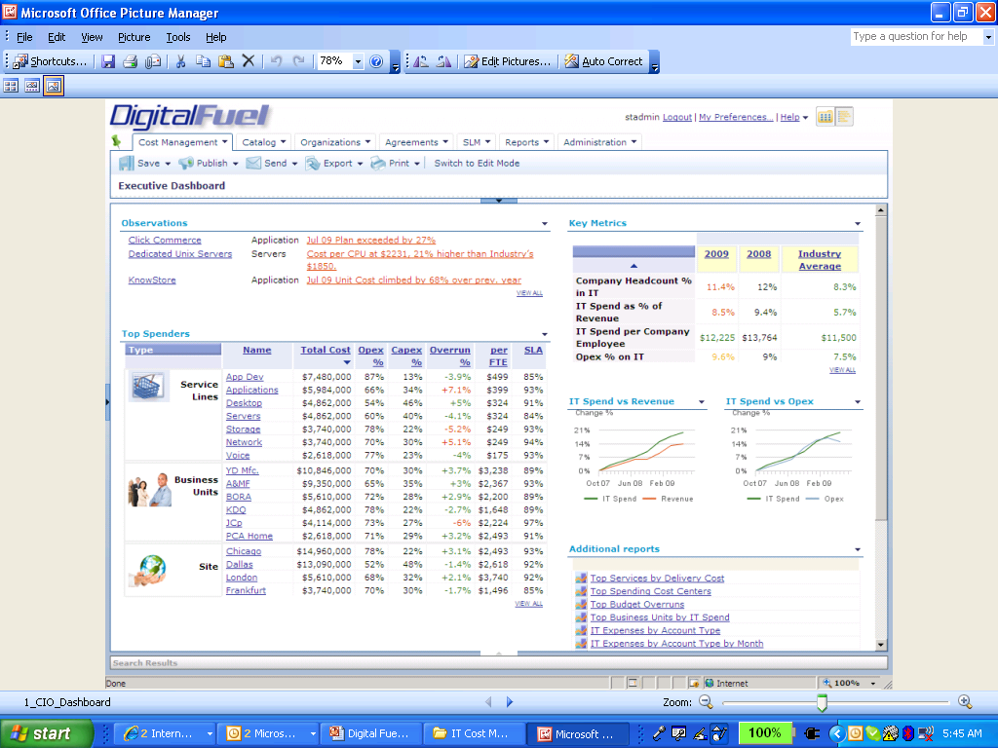
Proactive Cost Management – Where Are We Spending Money?

Slide 10
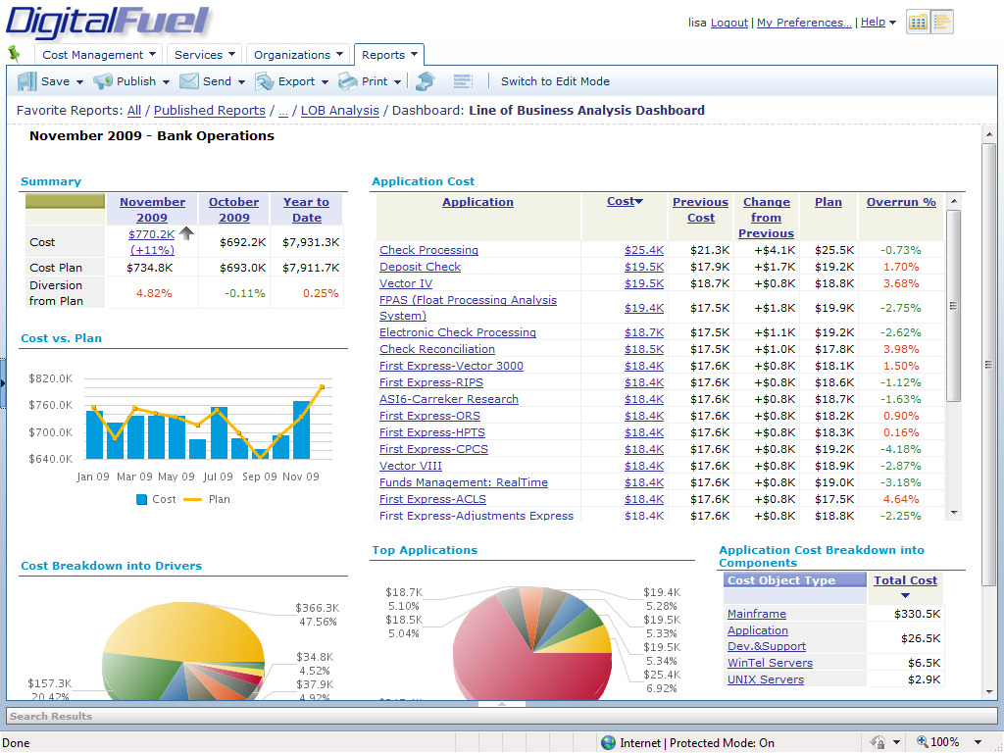
Visibility into a Specific Business Unit or Service Line

Slide 11
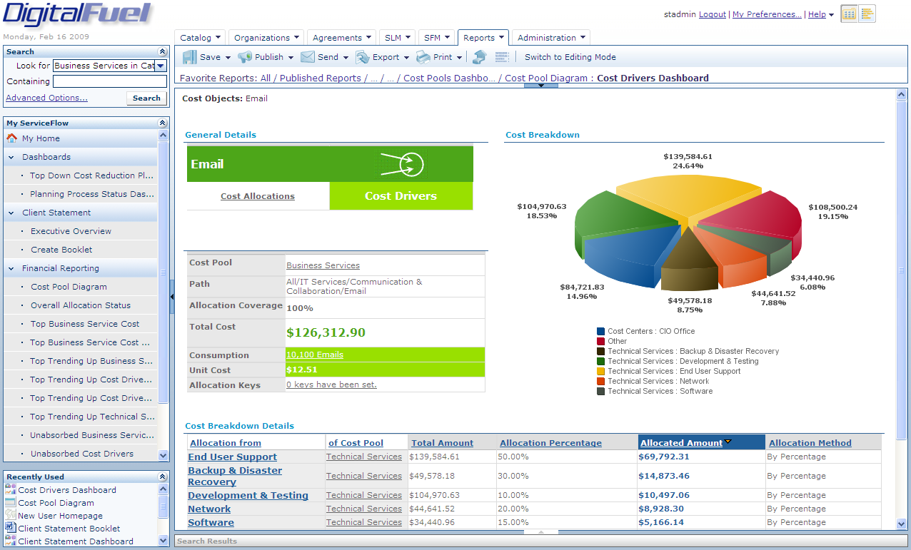
Drill Down To A Cost Driver Level

Slide 12
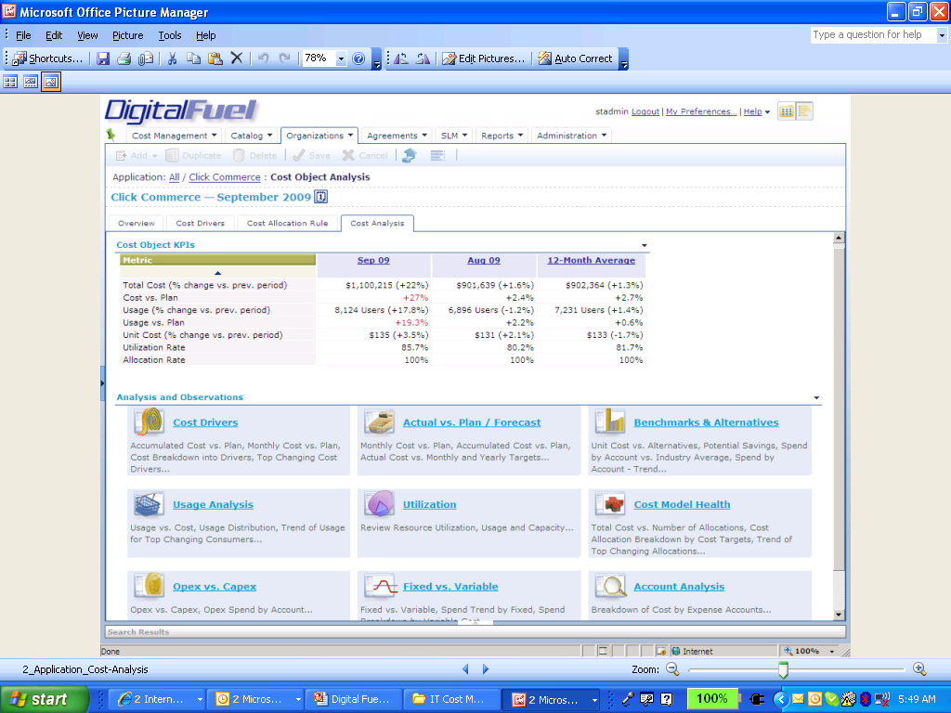
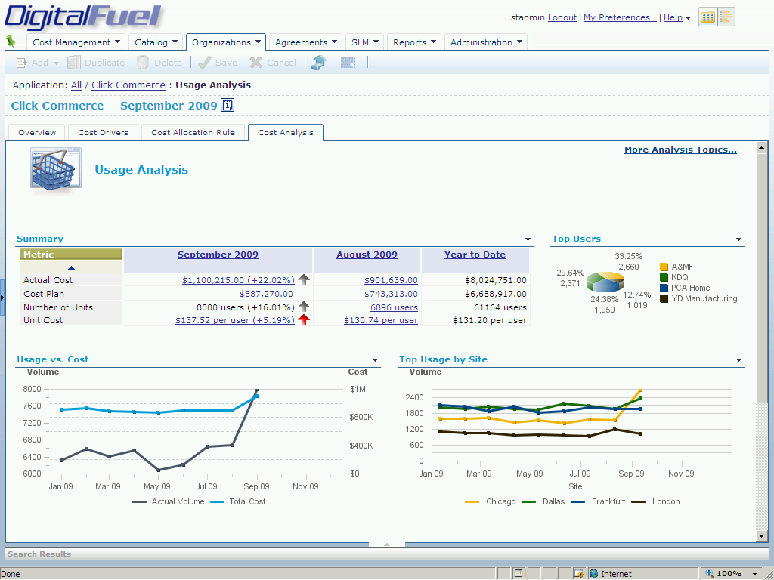
Complete Cost Analysis of Any Service

Slide 13
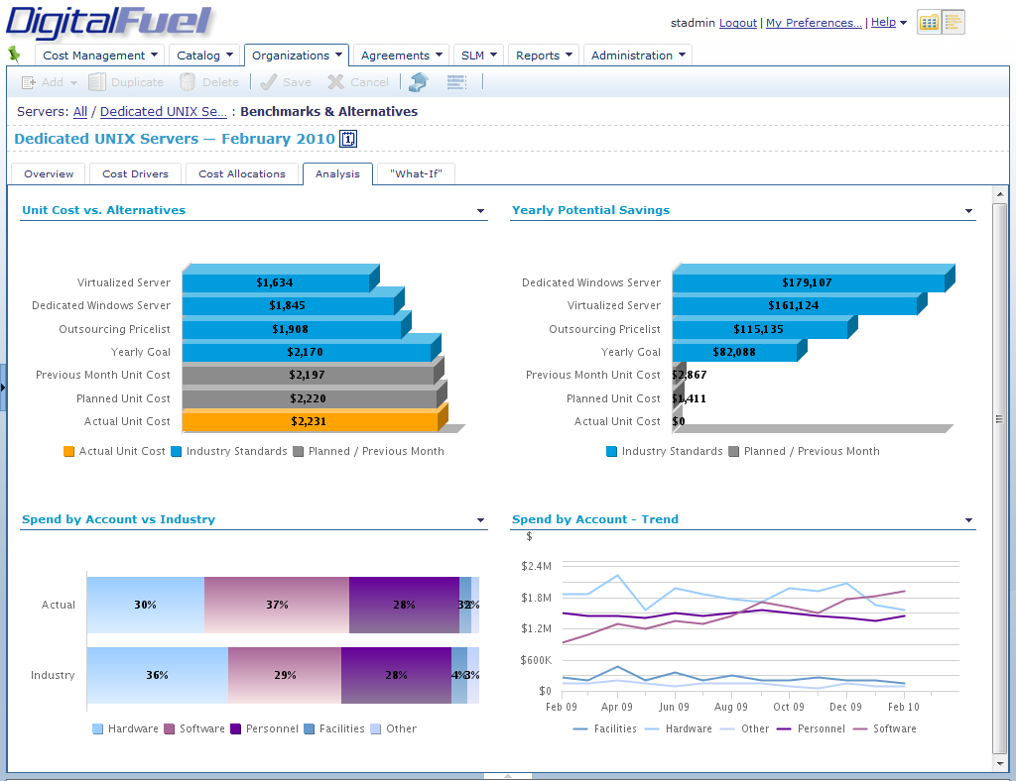
How Do We Compare Against Benchmarks & Alternatives?

Slide 14
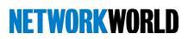

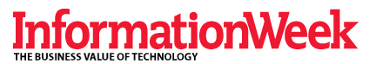
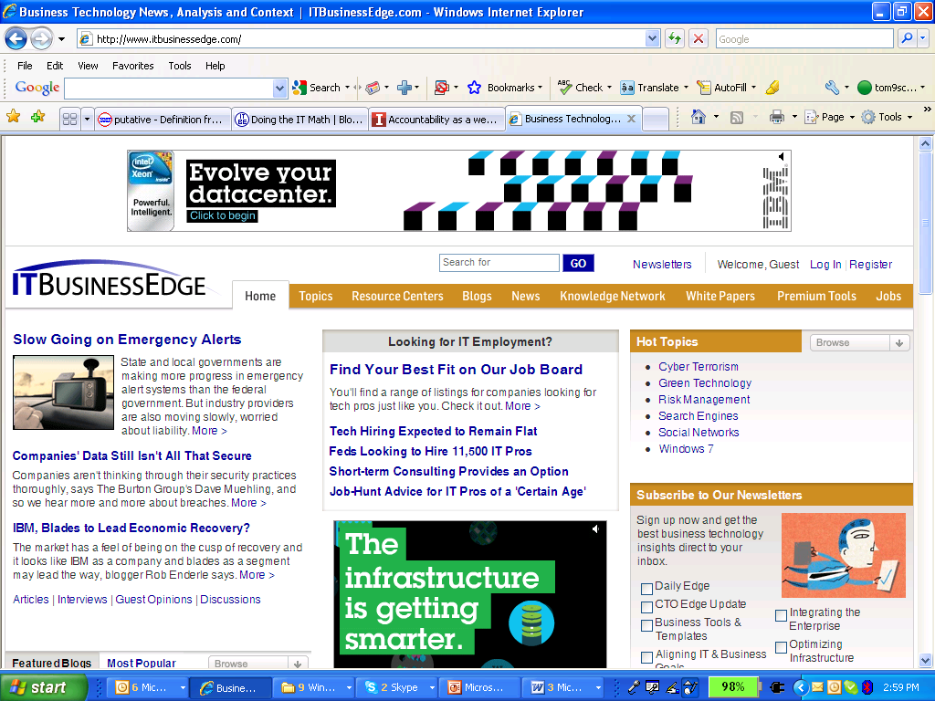
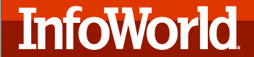
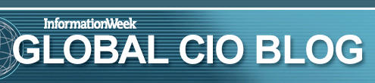
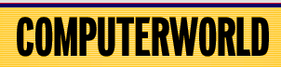
Realize True IT Savings with Digital Fuel IT Cost Management
Sign Up for a Cost Management Workshop Today at www.digitalfuel.com
Digital Fuel has the advantage of starting early and investing aggressively in the area of cost management.
What you really want to do is expose the business to the economics of IT in a way that makes sense and is understandable to them. Digital Fuel accomplished this with IT services used by each business unit.
Tools for managing the financial aspects of IT are getting more sophisticated and Digital Fuel is leading the charge.
Digital Fuel makes Accountability a weapon for IT with a
Cost management solution -- one of the hottest areas in IT.
Nationwide is using Digital Fuel to make sure it runs IT like a business, instead of like a Black Box Cost Center in other IT shops.
Cummins is using Digital Fuel to eye IT spend down to the individual!

Slide 15

Thanks
Feel free to contact me at any time,
Joe Pynadath
josephpynadath@digtialfuel.com

